Slide 1
Usability Testing
(with a pinch of agile)

Slide 2
Getting Started

Slide 3
Defining usability
“ The extent to which a product can be used by specified users to achieve specified goals with effectiveness, efficiency and satisfaction in a specified context of use”
– ISO 9241-11
Notes:
Source: International Organization for Standardization (ISO) 9241-11 Ergonomics of human-system interaction (https://www.iso.org/obp/ui/#iso:std:iso:9241:-11:ed-2:v1:en)
Effectiveness – ability for users to complete tasks accurately
Efficiency – the amount of time (or other resources) that the user has to employ in completing a task
Satisfaction – how happy the user is with the interaction

Slide 4


Types of problems we typically focus on
TAME DEFINABLE AND PREDICTABLE
WICKED HARD TO DEFINE AND UNPREDICTABLE
Notes:
Tame Problems:
Good agreement on problem definition
Linear approaches work well
Causality is easier to arrive to
Wicked Problems:
No agreement on problem
Difficult to predict
Difficult to determine cause and effect

Slide 5

Why we care about UX
Address gaps + disconnects in usability
Address issues in the user’s journey
Think it all the way through
Consider context of use
Maximize value to users
Notes:
At the end of the day, in our context, I have found it easiest to think about it in terms of addressing the gaps and disconnects between users and their abilities to perform tasks to achieve objectives with your products and services.
We also do UX to address problems that may occur during a person’s journey towards accomplishing a task with your product or service.
So, when we think about usability, were need to think it all the way though. This means that sometimes there will be problems that you will need to address, or at least consider, in terms of what is happening before your product or service becomes part of their journey, or after.
This is important, because for the most part, anything we produce is part of an ecosystem. Which means that there are things that may affect a person’s mindset while engaging with your product or service.
In other words, make sure your stuff provides value to them by being easy to use. Otherwise, they will probably start using someone else’s stuff.

Slide 6

Let’s talk: unmemorable user experiences
What are some examples of unmemorable user experiences?
Here’s one: ATMs
Notes:
DISCUSSION: Let’s think about interactions with product or services that are so good that they’re not even memorable.

Slide 7
The 3 questions of ux research
Who
What?
Does it work?

Slide 8
Types of Data Produced
Qualitative
Quantitative

Slide 9
Usability Testing – what it is, what it is not
Testing whether the thing works
Did you deliver what you said you would?
Notes:
What it is, what it is not
Usability testing is whether the thing is usable.
It’s essentially us making sure that what we made is usable in the sense that it enables users to complete tasks in the context of the product and/or service that we have built.
It is NOT user acceptance testing (UAT). UAT is checking to see whether we delivered the things we said we were going to deliver, as in the requirements we said we would deliver.

Slide 10
Placing Usability Testing in Context

Slide 11
So where In the ux process does usability testing fit?

Slide 12
DISCOVER
DEFINE
DEVELOP
DELIVER
How do users solve the problem now?
The user need(s) we will focus on
Prototype potential
solutions
Test with end users and the business

Slide 13

Audiences and problems – Who for, what for?
Who is your product/service for?
What do you know about them?
Which of their problems are you addressing for them?
Be a detective not a zoo visitor
What does their context of use look like?
Notes:
Who was your product or service designed for?
PRO-TIP: We are rarely our own target audience.
Are you sure you have identified the right audiences for your product or service?
What do you know about them? What they care about? What their environments are like?
Be a good detective and find these things out. Talk to some people and find out what their environments are like, what does their space look like? Sound like? Is it bright or dark? Noisy or quiet?
Avoid doing all your UX design and testing in a controlled environment. When you go see a puma in the zoo, you will not see actual puma behaviour. You will see puma in a zoo behaviour, but this will not really tell you much about how a puma interacts with its environment.
It’s the same for people. When they come to you into controlled environments, you are not necessarily seeing them in their natural environments, so you may miss clues or nuances that may greatly affect how they interact with your product or service.
Are you sure you have identified all of them?
This is an important part because it will help you in terms of making sure that you have the right proper testing your product/service for usability. They are who you are building this for, so they should be who you are testing with.

Slide 14
Let’s talk: Is usability testing always appropriate?
Scenario: You hear that some people are having some usability issues with your site and you look at the analytics and see some drop-off in your traffic to certain pages. What do you do?
Notes:
Let’s talk through this scenario.

Slide 15
Let’s talk: Is usability testing always appropriate?
Triangulate the issue
When you hear hoof beats don’t think zebras
Ask the right questions
What comes before/after?
What else is part of the experience context and/or ecosystem?
Notes:
Triangulate
Your first step should always be to try to triangulate the issue with more data points to make sure that you are not misunderstanding the root causes.
If your first instinct is to run some baseline usability testing, you may be missing the root cause.
If the issue is with network infrastructure, then you may not know this from doing usability testing in a controlled environment.
Asking the right questions
When you hear hoofbeats, think horses, not zebras.
This means that look for the most obvious explanations first. If the data (qualitative and quantitative still doesn’t make sense, then you can start considering more exotic causes for the problem. Otherwise, you may tend to overthink and over-engineer the problem and your approach to a solution.
Ask the right questions
Think about things like:
what comes before the problem is experienced and what comes after?
What else is part of the experience chain that may be the cause or contributor to the problem being experienced?
What parts of this are under your influence and/or control? And who in your ecosystem had more influence/control thank you do? And are they aware of the issue and the impact it has on the people being affected by it?

Slide 16
Understanding Your Realities

Slide 17

Understanding your realities – UX where you are
What does usability testing look like where you are?
Who’s involved?
When and how is it done?
Notes:
What does usability testing look like where you are?
Who is at the table when planning, approving, executing, analyzing, decision-making?
When is it done?
How is it done?

Slide 18
Types of Testing
Notes:
There are mainly 3 types of testing that we talk about.
Low fidelity
Medium Fidelity
High Fidelity
Before we start to talk about the types of testing though, let me talk to you about proposing your testing and communicating the recommendations.

Slide 19

Types of testing – Low-Fi
Strategic level
Examples: Rapid Elicitation sessions, wireframe walk-throughs and discussions
Validation of design vision, direction and audience
Value: validate what we know against initial designs and iterate in a quick and cheap way.
Notes:
I usually refer to this as strategic level ux because at this level we are thinking through concepts with users.
Example: Rapid Elicitation sessions, wireframe walk-throughs and discussions with a group of 4-8 people
You start with identifying the problem as you understand it currently and its context, while engaging in a brief discussion to validate with the group
Think of this a testing the vision of your solution/approach at a high level.
This will provide mostly qualitative data.
This will typically answer questions like:
Are you heading in the right direction?
Are you considering the right things?
Are you talking to the right people?
Do you have the right information to move forward?
The value of this is that we are validating what we know against initial design assumptions in a way that is quick and cheap to iterate and refine the approach to the solution.

Slide 20


Types of testing – Mid-Fi
Tactical level
Examples: Moderated usability testing, first-click testing
Testing design assumptions, looking for patterns of use (+/-)
Value: validate design assumptions in a more detailed way.
Notes:
Tactical level UX
Example: Moderated usability testing
Individual: one on one with participant and researcher, plus one or two note takers. This is best done remotely to avoid observer bias.
Clickable Mockups (or sometimes wireframes) with people performing set tasks through moderated means and then discussing the experience.
You can also use online tools such as Optimal Workshop’s Chalkmark to have them point to where they would click to complete a task. This will provide more quantitative data that you can use to compare to moderated testing data and look for areas of discord to follow up on.
You observe a person as they try to complete specific tasks, and then discuss their experience.
Is your design appropriate and relevant to the people you are making it for?
Is it helping them address their issues?
Is it improving their efficiency, effectiveness and satisfaction with the process of completing their tasks, and ultimately your product/service?
Value: Validate design assumptions with a more tangible product with users to start to gather information about how they interact with the product/service in more detail.
Testing here is also good because it is still quick and cheap to iterate and correct things. Especially when you realize that you have missed an important piece or that design assumptions you had made are less valid than you thought.
Usually produces more quantitative data, although some quantitative data can be produced as well.

Slide 21

Types of testing – Hi-Fi
Also tactical level
Examples: Online self-paced testing,
Testing design assumptions, looking for patterns of use (+/-)
Value: Further fine-tuning design in terms of interactions, flow, labels, etc., but in a live context.
Notes:
This is also tactical level UX
Watching users doing through concepts
Example: Online self-paced using tools such as hot jar to view heat maps of where they click
You can either present users with tasks for them to try to complete and ask them survey-style questions in the tool after, or you can just let them look around and pop up sentiment questions (“How did you feel about...”, “What did you think of...”), pop-up kiosks allowing people to complete certain tasks as well as exploring at will while you observe and ask questions after. Also, this can be part of continuous testing in terms of tools such as hotjar, or tied to certain KPIs as part of your analytics. So, if a KPI falls under a certain pre-established tolerance level, it can prompt you to go do some research to find out why that is happening.
By the time you get here, you want to be doing minor changes to your usability. This is not to say that you will never come upon that edge case that nobody caught and have to go back and rework a bunch of things. It just means that if you have iterated properly through the first two levels, the likelihood that you will have missed something is greatly diminished.
Value: Further fine-tuning of interactions, flow, labels, etc, but in a live context.
Usually produces more quantitative data

Slide 22
That Pinch of Agile

Slide 23
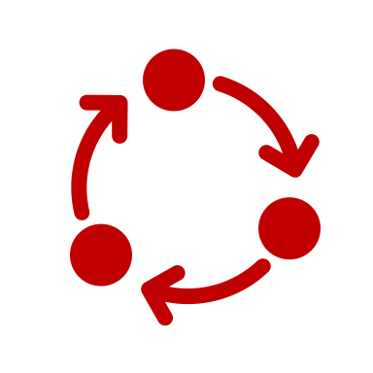
That pinch of agile – use cases AND user stories
Story map for requirements
Use case
This is the system behaviour, in terms of what it needs to enable for the user
User story
This is what the user wants/needs to be able to do through the system
Notes:
OK, so before we get into the definitions, you need to know that there is often a difference of opinion about which is which, but in the UX and Business Analysis world, we tend to use these definitions. So, if you’re going to be working with IT on your project and sharing your story map, you will want to make sure you agree on a definition before you start.
Typically in an agile environment you will gather your requirements and distil them into a story map that is broken down by use cases and user stories. This is useful because through your initial engagement sessions with business stakeholders and users you will get a lot of feedback that can be aggregated into more easily actionable use cases and user stories.
An example of a use case would be. “Browse our Catalog”.
An example of a user story would be, “I want to be able to add a product to a wish list so I can come back to it later”.

Slide 24
That pinch of agile – prioritization and planning
Prioritization
Red/Green + MoSCoW
The Backlog
Sprint planning
Notes:
Now that you have your use cases and user stories, you need to look at prioritizing them. The two ways of doing this that I prefer are the Red/Green and MoSCoW exercises.
Both of these will mean sitting in a room with your story map, and the people that you would have identified in your project charter as part of your decision-making governance team. If you don’t happen to have that, make sure that you have your project manager, and people from dev and design, as well as someone from policy to tell you when something is mandatory or a no-go.
In a red/green exercise, you go through each user story and people vote with a red or green card in terms of saying yes or no to it. This one is quicker.
A MoSCoW exercise is a little more involved because you identify things as: Must do right now; Should do; Could do; and Won’t do right now (or ever).
What comes out of this is a prioritized backlog. The backlog is essentially your to-do list.
You will use this to-do list to pick from when you are planning your sprints. A sprint is basically a short period of time, typically between 1-3 weeks, in which you are quickly completing design, development and testing of a set of user stories from your backlog.
The trick is to pick the right amount of things to do in a sprint so that you can get them all done. Just remember that not all user stories are created equal, so some may take more to implement than others, depending on their dependencies on other parts of your project.

Slide 25
Testing Strategy

Slide 26

Testing Strategy
Objective
Methodology
Metrics
Deliverables
Notes:
Your testing strategy will help you create a high-level vision for your testing. This will include the objectives for your testing, the types of testing methods, metrics, and deliverables.
This will be very useful to ensure that you have alignment with your objective to overall project objectives, as well as transparency around your methodologies. In addition, communicating the metrics you’re after and the deliverables for your research will provide some legitimacy to your work in your organization by being explicit about the value you are providing.

Slide 27
A Typical Usability Testing Sequence

Slide 28
A Typical usability testing Sequence
Planning & Logistics
Execution (sprints)
Analysis
Recommendations
Notes:
Assuming that you have This is what a typical testing sequence looks like. Now, let’s unpack the different steps.

Slide 29
A Typical usability testing Sequence – Planning & logistics
Testing Scripts
Activity Briefs
Research question
Use case/ story
User tasks
Follow-up questions
Methods
Logistics
Informed consent
Notes:
Now that you have your testing strategy, the first step is planning and logistics. This is made up of Activity Briefs, and your Testing Scripts.
Once you have your strategy, this will free you up to use activity briefs to do your operational planning and logistics. This means identifying your research question for what you’re testing, methods for testing, use case and associated user stories, and logistics in terms of who, when, and where. Best of all, you can do this in one page, 2 maximum.
Finally, you develop your testing script. Here you get to develop the appropriate user tasks and follow-up that will enable you to gather answers and insights to your research question. Also, don’t forget to include an introduction to what you’re doing, the types of information you will be gathering and how you will be doing it. Informed consent is important in research with people, especially if you’re recording them.

Slide 30
A Typical usability testing Sequence – Execution (sprints)
Invite Participants
Moderated Usability Testing
Rapid Elicitation Sessions
Task(s) in flow
Content
User flow
Task(s)
Research highlights
Wireframe(s)
Task(s)
Script
Data Logging
Online Testing
Data Logging
Tasks
Script (if required)
Analytics
UI Flows

Slide 31
A Typical usability testing Sequence – Analysis & Recommendations
Recs
Analysis
Triangulate insights
Communicate in actionable ways
Prioritize based on impact, scope and frequency
Ask “So What?”
Align to addressing business needs
Identify severity levels
Notes:
Analysis
Always try to triangulate your insights. So look for evidence of an insight from a variety of sources to ensure that you are interpreting it correctly. E.g. anectdotal data from users, observations from researchers, analytics, and workarounds.
Prioritize based on impact (effects of the issue), scope (how many people and/or systems does it affect), and frequency (how often does it happen).
Identify severity levels from: Critical (prevents task completion); Serious (creates high friction in task completion); Medium (increased frustration with task completion); Low (usually a quality of UX issue like visual or typos).
Recommendations
Communicate findings and insights in actionable ways
Always ask yourself, “So What?”, as a way of ensuring that you are providing information that will have value to whomsoever will be consuming it. Non-actionable data can become noise and diminish the perceived utility of your work in UX.
As we used to say in advertising, we make art that work, not works of art. I.e. we engage in UX to address business issues on behalf of the people using the products and services from that business. So, always make sure that your activities and findings are aligned to those issues and that you are contributing towards their solution.

Slide 32

Communicating testing – proposal + Recommendations
Proposal
Value: Why should I invest in this?
Outcomes: What can I expect to get out of this?
Recommendations
Insights: What did we learn from our testing?
Actions: What we recommend you do as a result of what we learned.
Notes:
In my experience, whenever I presented to senior management about UX testing we wanted to do, I would start talking about what we were wanting to do, methodologies, logistics, etc. and their eyes would start to glaze over. It’s not that they were not interested necessarily, but more about the fact that I wasn’t really communicating to them what they cared about at their level. So I started doing a brief intro on the activity, and then jumping straight into value and outcomes. It worked. Then, if they wanted more of the other information, I could give it to them, but only if they asked. It gave them the information they needed to make a decision, and the opportunity to ask for more if they felt they needed it.
So, value should be framed in the context of why they should invest in this, or to put it another way, “why am I paying for this?”. E.g. Risk mitigation, outreach to previously un-engaged audiences, data for a largely unknown part of a project, etc.
Outcomes is about what they can expect to get out of the exercise in a way that is tied to the value statement. It’s like stating the SMART objectives for the research activity. E.g. An understanding of the user audience during a part of a process in terms of time on task, or some data on why there is so much error being produced by a part of a process or during an interaction.
In terms of the recommendations after you have run your study and done the analysis, you want to present them in terms of the highlights of the things that you learned, and then connect those to actions that can be taken to make improvements and address problems. Also, keep in mind that sometimes your insight may well be that you need to do more specific research or reframe your research question. This is research, which means that sometimes what we learn is that we need to learn more. That’s ok.

Slide 33

TIPS – Analysis and Recommendations
Analyze quickly and collaboratively
Research is observing behaviours NOT asking for opinions
Focus efforts on high priorities first
Notes:
Analyze data quickly and collaboratively. Deal with it as soon as you get it and put it into action.
Research is NOT asking people what they like. It’s more objective and about observing behaviour, not about preferences.
Focus your efforts on the most important stuff. You can always come back and test minor stuff later.

Slide 34
Tool Tour

Slide 35

Data Logging
Tool to capture observations on everything you see and hear
Coded and categorized
Time stamped
Typically used with ethnographic research + moderated testing

Slide 36
TIPS – Observing participants
Remind them to think aloud
Use script
Listen for clues
Details matter
Notes:
Remind your participants in usability testing to think aloud as they participate in task completion. This will help you to capture observations as well as making their reasoning and actions explicit
Use your script as a guide to help you with the structure of your interview to make sure you’re following the appropriate sequence for your tasks.
Listen for clues and don’t let little comments slide as they could be pathways to more insights about the usability of your designs.
Details matter, so look for places where people stumbled, ask about what that meant to them. This will help you further understand why they do things the way they do them.

Slide 37
Let’s Try It while watching a test
Capture Observations
Capture general comments
Capture +/- Comments
Identify start and end of tasks
Notes:
Try an exercise in capturing observations while watching a video of a usability test.

Slide 38


Slide 39



Optimal Workshop
Notes:
Optimal workshop offers a suite of tools for usability testing that can take you through most parts of the UX design process such as card sorting and tree testing.
The tools that are most relevant to us in the context of usability testing are the online survey tool, the first-click testing tool, and the qualitative feedback analysis tool.
The tools are all multi-lingual, including English and Canadian French.

Slide 40
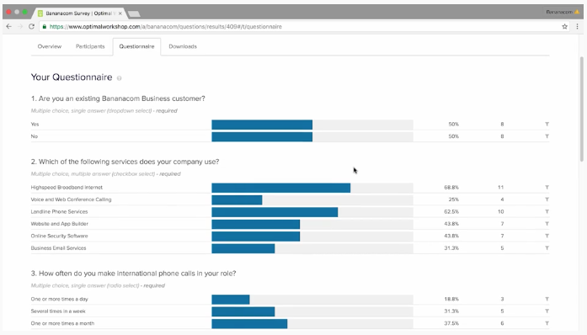
Optimal - Questions
Quantitative and qualitative feedback
Analysis online or download data to excel
Standalone studies
Pre or post studies
Notes:
You can set up questions to provide quantitative and qualitative feedback and online links can be easily shared
Results can be analyzed online or you can download them to excel for additional manipulation of data
You can have it as a standalone study or as a pre-study questionnaire or post-study follow-up.

Slide 41
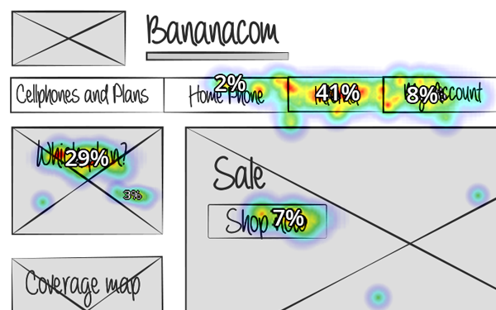
Optimal - Chalkmark
First-click testing tool
Test labels and placement of design elements
Results in the form of task completion and heatmaps
Notes:
First-click testing is useful to get more gut reactions for designs. There are some limitations with this because this shows the users a static image, from which they are asked to click on the location they think would help them complete a task.
It is useful to test labels as well as the placement of design elements on screen
Results are in the form of task completion, based on identified areas for success, and heatmaps that give you insights into the effectiveness and efficiency of designs to enable task completion.

Slide 42
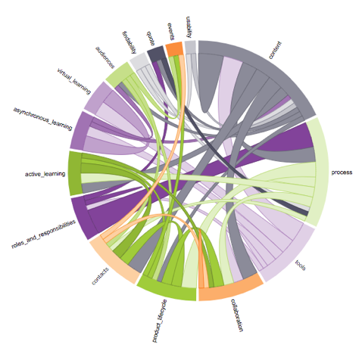
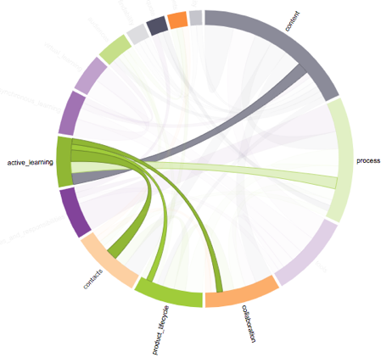
Optimal - Reframer
Capture/record observations
Tagging
Qualitative view of quantitative data
Create themes
Use visualizations to look for insights
Notes:
Reframer is a good tool to capture and record observations. The downside is that you need to be online to be able to use it.
The tagging is a good feature and you can create tag groups, and colour code them as well to help with organizing your qualitative data
When you tag your qualitative data you can then start to create quantitative views of it in terms of how frequently certain tags appear.
In addition, you can create themes based on groupings of tags, giving you further insights and also allowing you to get a sense for what is being said or captured within those themes.
The tool also offers visualization tools such as the chord diagram that can help you insights about how different tags are connected, so that you can build additional themes and look for further insights.

Slide 43
Resources

Slide 44

Some Resources
ISO 9241-11 Ergonomics of human-system interaction
Think Like A UX Researcher by David Travis and Philip Hodgson
Sample Size Calculator
Notes:
ISO 9241-11 Ergonomics of human-system interaction (https://www.iso.org/obp/ui/#iso:std:iso:9241:-11:ed-2:v1:en)
Sample size calculator (https://www.calculator.net/sample-size-calculator.html?type=1&cl=95&ci=10&ps=500&x=61&y=22)

